Slide 1

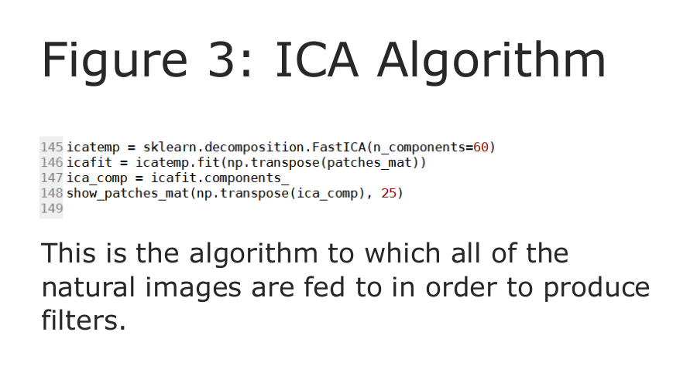
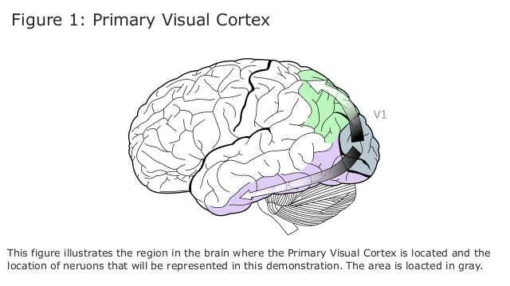
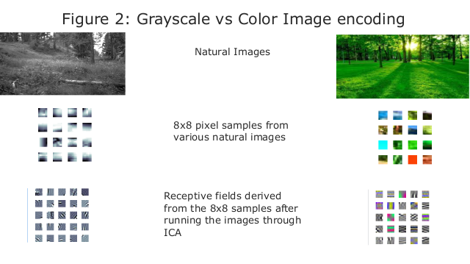
Efficient Neural Coding of Images and Video to Derive Receptive Fields
Harmeet Singh, Patrick Nolan, Zachary Barrett, Mark V. Albert
Abstract
Methods
Discussion
The way in which the brain efficiently encodes images is integral to the field of Computational Neuroscience. Through millennia of evolution, the brain has become predisposed to rapidly respond to natural images. A natural image is an image of an object that has been consistently present throughout the evolution of humans (i.e. trees, rocks, water, animals, etc.). In this experiment, natural images are taken and fed through an algorithm akin to the one that the brain employs. This algorithm, Independent Component Analysis (ICA), breaks these natural images into separate, easier to compose parts. ICA is used for all image processing in exactly the same manner, whether that be viewing greyscale images, color images, or even video. Using ICA, our program created 8x8 pixel "fields" of individual neurons being activated, displaying what part of a neuron responds to the natural image, and with what intensity. The filters that were generated for grayscale images map us a cohesive picture of neural reaction. The filters for color images show that levels of light primary stimuli while color is secondary stimuli, as most receptive patches were still entirely in black and white. By becoming acquainted with how the brain encodes images, the field of Computational Neuroscience can be understood more thoroughly which allows for more in depth topics to be delved into in the future. This process can help further the understanding of how the brain interprets images at a primary level.

